Slide 1

Final Project Implementation of Deep Learning on Video Analytics
Submitted by
S. Akshithraj
Ravi Teja Kandavalli
Sachin Ahankari
Sateesh Saini
Under the guidance of
Mrs. Vimala Mathew
Scientist/Engineer ‘D’,
National Institute of Electronics and IT, Calicut

Slide 2

A video shot in Kaziranga, Assam

Slide 3
Introduction
Problem Statement:
Video classification with
CNN, RNN & CRNN.
Solution Methodology.
1. Extraction of image frames from videos.
2. Training the top layer of an Inception v3 CNN
with the input images.
3. Extraction of a sequence of images from videos
with a constant size and equally spaced.
4. Training an LSTM RNN for classifying videos based on the image frames.

Slide 4
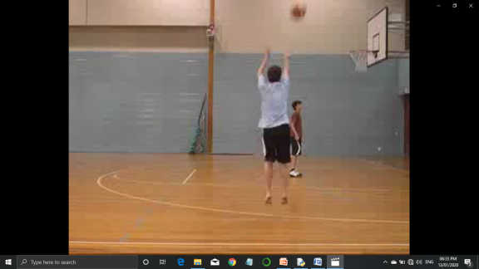
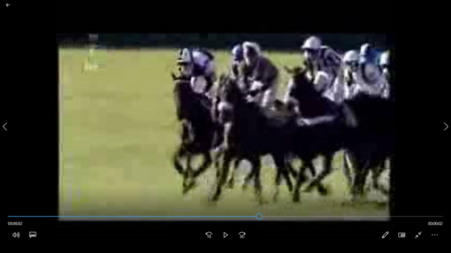
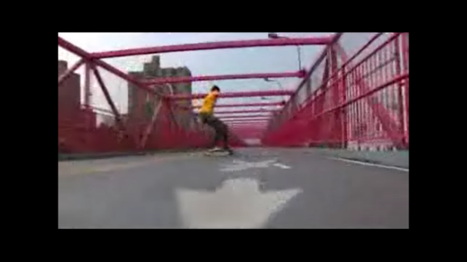
Dataset
UCF101 Dataset.
Includes 13320 videos
with 101 action sequences.
https://www.crcv.ucf.edu/data/UCF101.php

Slide 5
The libraries we used
import csv
import os.path
import pandas as pd
import sys
import operator
from processor import process_image
from keras.utils import np_utils
from keras.preprocessing.image import img_to_array, load_img
from processor import process_image
from keras.models import load_model
import numpy as np
import operator
import random
import glob
from keras.applications.inception_v3 import InceptionV3
from keras.optimizers import SGD
from keras.preprocessing.image import ImageDataGenerator
from keras.models import Model
from keras.layers import Dense, GlobalAveragePooling2D
from keras.callbacks import ModelCheckpoint, TensorBoard, EarlyStopping

Slide 6
Considerations for Training/Test Data Split
A group cannot span across
datasets.
Regular Expression for Extracting
the Group and Index Numbers ^\w+_\w+_g(\d\d)_c(\d\d)
Folder Name as the Category Name
Groups to be Shuffled During Assignment
Same Group Assignment for both CNN and RNN Training

Slide 7
CNN
This network takes fixed size inputs
and generates fixed size outputs.
CNN is a type of feed-forward
artificial neural network with
variations of multilayer perceptrons
designed to use minimal amounts
of preprocessing.
CNNs use connectivity pattern between the neurons.
This is inspired by the organization of the animal visual cortex, whose individual neurons are arranged in such a way that they respond to overlapping regions tiling the visual field.

Slide 8
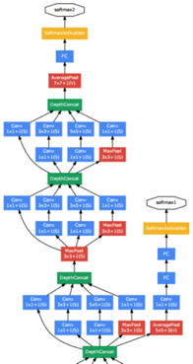
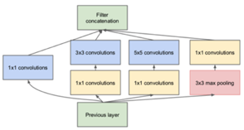
Inception v3 CNN for transfer learning
What is an inception network?
An inception network consists of multiple
inception blocks chained together.
What is an inception block?
A single inception block tries to find the perfect
combination of CONV blocks with different sizes in
addition to a MAX POOL layer.

Slide 9
Inception v3
It will be used for reducing the dimensionally of the input.
Top layer will be removed and trained separately.
conv_base=InceptionV3(weights=‘imagenet’, include_top=False,input_shape(240,320,3))
3. Video frames have a pixel size of 240 x 320
with 3 channels.
V=cv2.VideoCapture(‘/Users/AKSHITH/Downloads/UCF101/UCF-101/v_Boxing_g01_c01.avi’)
success, image=v.read()
Image.shape
Out: (240,320,3)
4. Every 25th frame is chosen for input to decrease the amount of data.
5. Extracted frames are written into a directory structure starting with the type of dataset.
6. 95% of the input data goes for training and the rest for validation.
7. All input image will be first passed through the CNN up to the top layer. The last layer dimension is 6 x 8 x 2048.

Slide 10
Shaping the Data
Data shape for the training data features and labels: ((85807, 6, 8, 2048), (85807, 101)).
Data shape for the validation data features and labels: ((7734, 6, 8, 2048), (7734, 101)).
Training the top part with a Dense layer
of 256 neurons, a Dropout layer
with 0.5 probability, and a softmax layer: model = models.Sequential() model.add(layers.Dense(256, activation=’relu’, input_dim=6 * 8 * 2048)) model.add(layers.Dropout(0.5)) model.add(layers.Dense(101, activation=’softmax’)).
Epoch size of 30 and batch size of 100 were used.

Slide 11
A part of CNN code
# Get all our test images.
images = glob.glob('./data/test/**/*.jpg')
for _ in range(nb_images):
print('-'*80)
# Get a random row.
sample = random.randint(0, len(images) - 1)
image = images[sample]
# Turn the image into an array.
print(image)
image_arr = process_image(image, (299, 299, 3))
image_arr = np.expand_dims(image_arr, axis=0)
# Predict.
predictions = model.predict(image_arr)

Slide 12

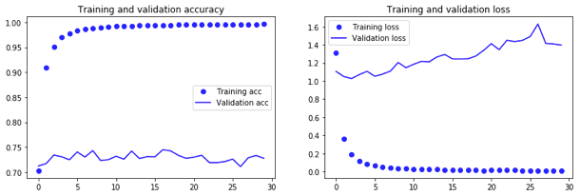
Accuracy and loss graphs for training and validation data:
The main objective here is to train the dense layer.

Slide 13
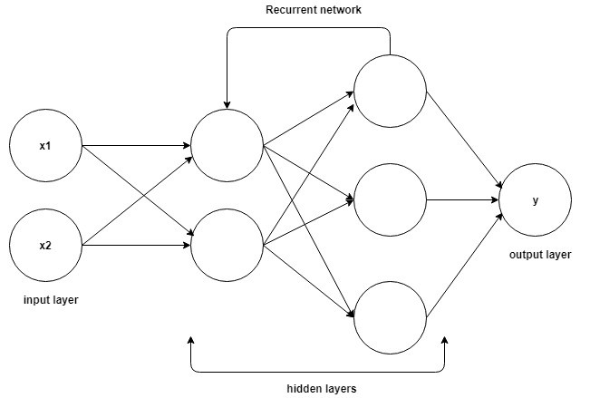
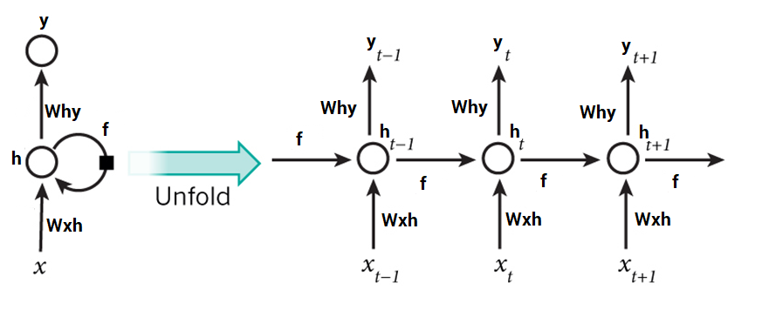
RNN
The output from previous step are fed as input to the current step.
The main and most important feature of RNN is Hidden state, which remembers some information about a sequence.

Slide 14
Custom RNN
A fixed sequence length (80) is used.
Sequences are extracted
equally distanced.
Each image is first fed into the
CNN to have the feature
length of 256.
Data shape for the training data features and labels: ((11283, 80, 256), (11283, 101))
Data shape for the validation data features and labels: ((1008, 80, 256), (1008, 101))

Slide 15
Architecture
Architecture has an LSTM of
200 neurons and a softmax layer: model = Sequential() model.add(LSTM(200, input_shape=(80, 256))) model.add(Dense(101, activation=’softmax’))
The network can learn the the features from the training set very easily so there is no need to add more layers and further complicate the architecture.
Epoch size of 30 and batch size of 64 were used.

Slide 16
A part of RNN code
class RNN(nn.Module):
def __init__(self, input_size, hidden_size, output_size):
super(RNN, self).__init__()
self.hidden_size = hidden_size
self.i2h = nn.Linear(input_size + hidden_size, hidden_size)
self.i2o = nn.Linear(input_size + hidden_size, output_size)
self.softmax = nn.LogSoftmax()
# self.softmax = nn.LogSoftmax(dim=1)
def forward(self, input, hidden):
combined = torch.cat((input, hidden), 1) # combined 57+128=185
hidden = self.i2h(combined) # hidden = (1,128)
output = self.i2o(combined) # output = (1,18)
output = self.softmax(output)
return output, hidden
def initHidden(self):
return Variable(torch.zeros(1, self.hidden_size)).cuda()

Slide 17
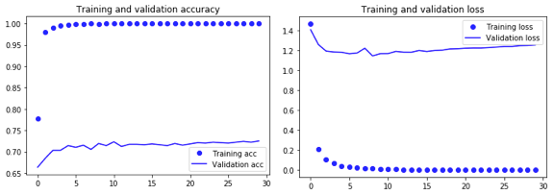
Accuracy and loss graphs for training and validation data:
The network could achieve 100% accuracy for the training set very quickly but got stuck at around 72% — 73% for the validation set.

Slide 18
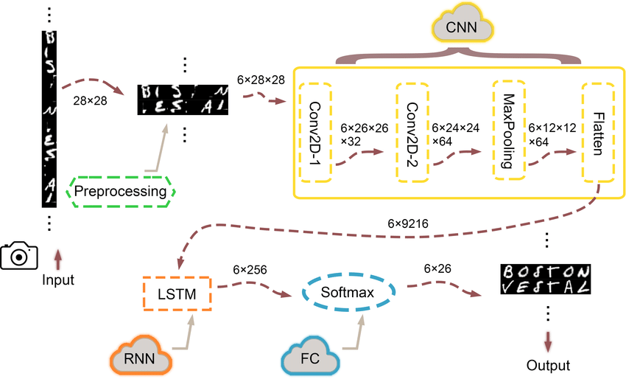
Convolution Recurrent Neural Network (CRNN)
CNN+RNN = CRNN model is
a pair of
CNN encoder and RNN decoder.

Slide 19
CNN + RNN = CRNN
The CRNN model is a pair of
CNN encoder and RNN decoder.
[encoder] A CNN function encodes
(meaning compressing dimension)
every 2D image x(t) into a 1D vector z(t) by
fcnn[x(t)]=z(t).
[decoder] A RNN receives a sequence input
vectors z(t) from the CNN encoder and outputs
another 1D sequence h(t).
A final fully-connected neural net is concatenated at the end for categorical predictions.

Slide 20
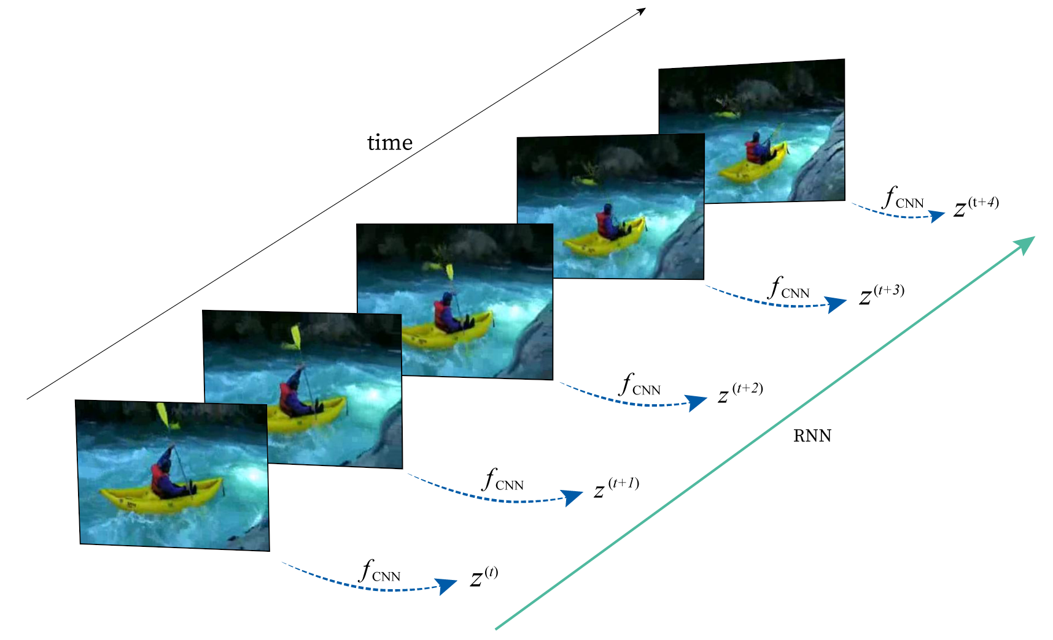
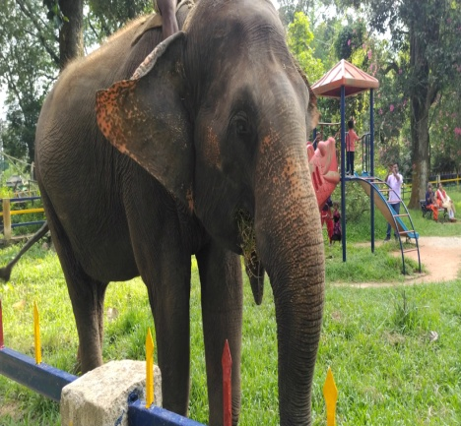
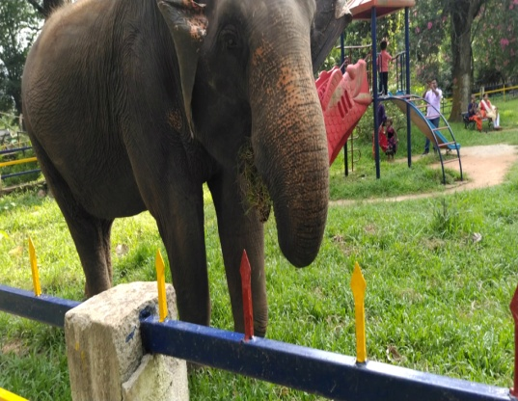
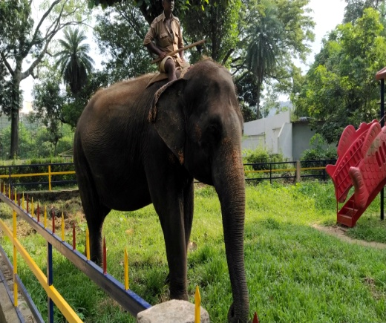
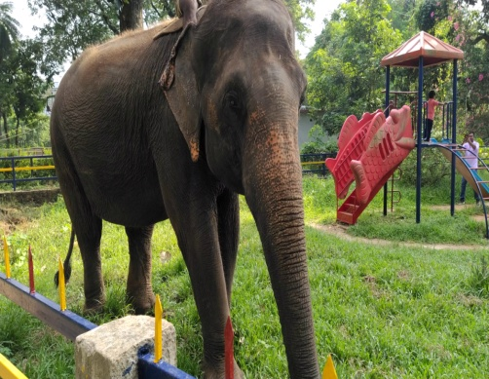
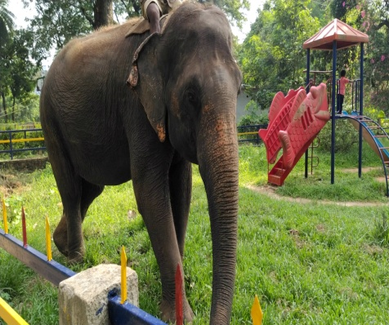

Slide 21
What’s in CRNN?
In CRNN, CNNs are able
to extract high level features
that are invariant local variations.
RNNs enables the networks to
take temporal aggregation of extracted
features.
CRNN have shown excellent performance in for document classification and extended to use audio detection and music emotion recognition.

Slide 22
What did we get to know with this project attempt?
Accuracy values for the attempted
solutions with regards to
UCF101 dataset are around
70–75%.
CNN is suitable for spatial data such
as images & RNN is suitable for temporal data,
also called sequential data.
CNN is considered to be more powerful than RNN because RNN includes less feature compatibility.

Slide 23
Thank You

